Slide 1

AItrain Hub
AI personal trainer that fit your need
Notes:
Hi everyone, welcome to our presentation. Today we will focus on AITrain: an application where AI could both be your Personal Trainer and your gym buddy!

Slide 2

Problem
- Lack of personalized guidance
- Time constraints
- Motivational challenges
- Access to expertise

Slide 3
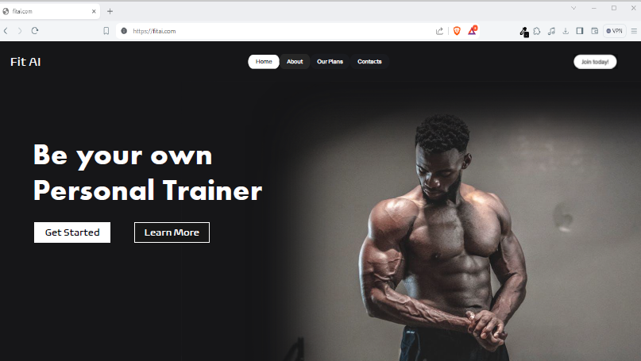
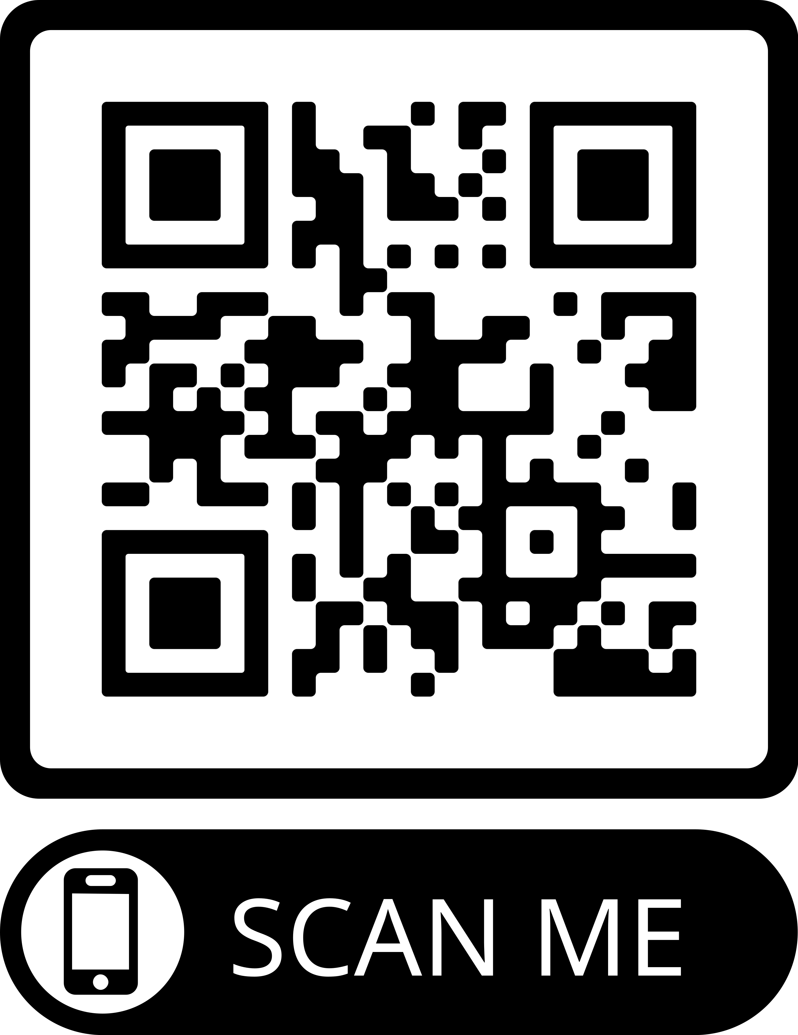
Solution

Slide 4
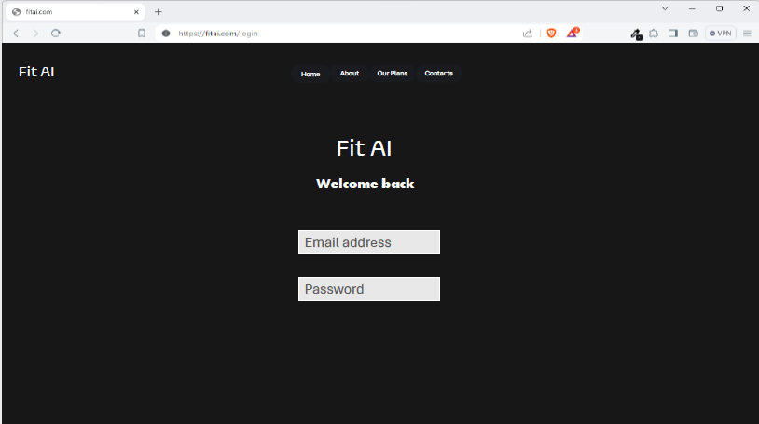

Slide 5
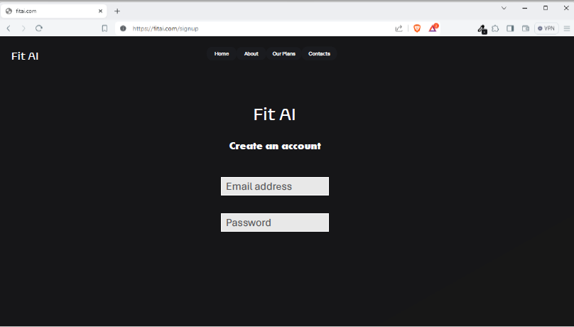

Slide 6
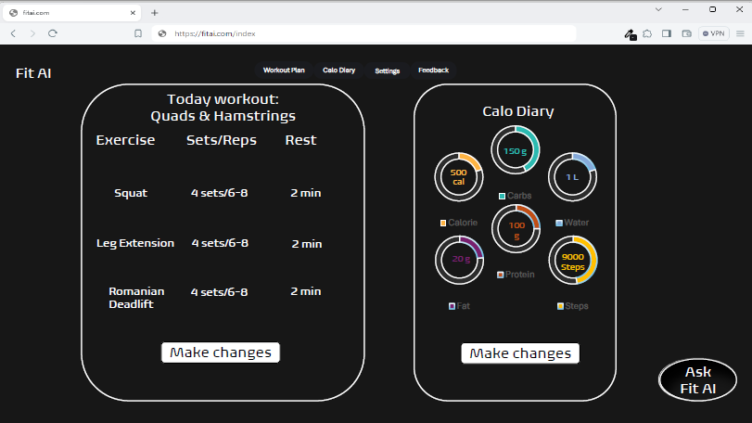

Slide 7
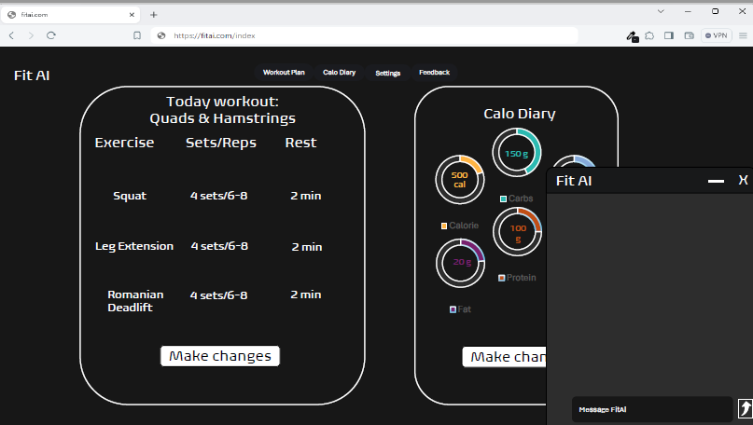

Slide 8
Fit AI
Workout Plan
Calo Diary
Settings
Feedback
Apr 8, 2024
Breakfast: 400 calories
Scrambled Egg White: 140 calories
2 eggs 12g protein 10g fat
128 g
Whole wheat toast: 140 calories
6g protein 2g fat 24g carbs
240 g
Avocado: 160 calories
½ avocado 2g protein 15g fat 8g carbs
Add More
Lunch: 165 calories
Grilled chicken breast: 165 calories
100g 31g protein 3.6g fat
Add More
1200 – 565 + 500 = 700
Goal
Calo Intake
Calo
burned
Calo
remaining
Dinner:
Add More

Slide 9

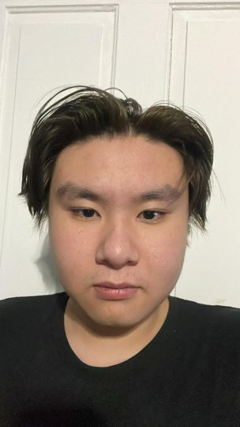
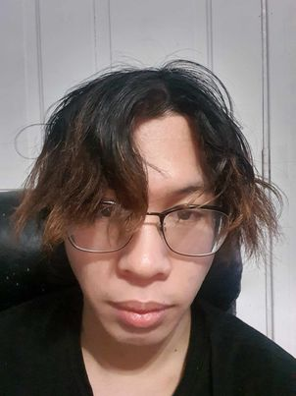
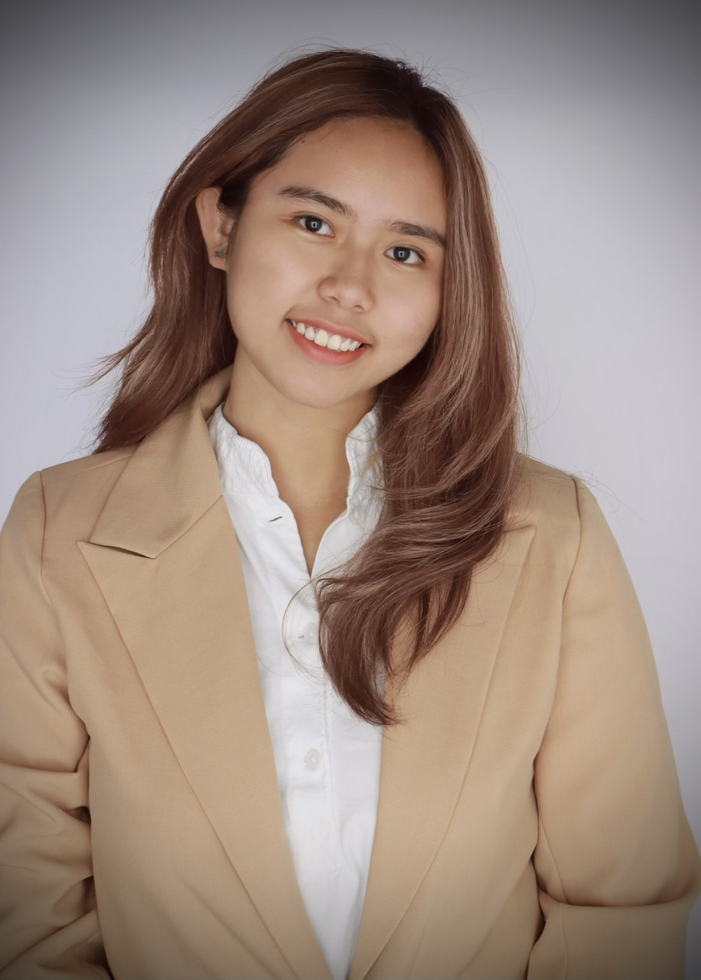
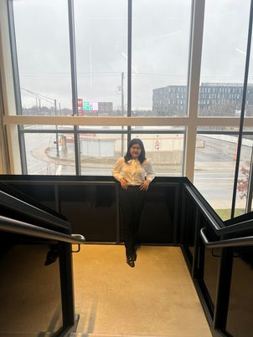
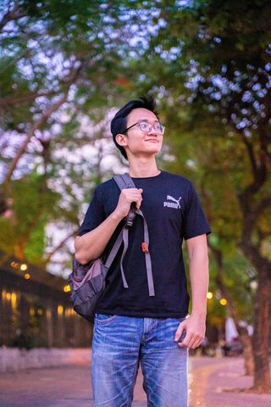
Team
Vanessa (Anh) Vo
Project Manager
Thinh Vo
Software Engineer
Hoang Nguyen
Back-end Developer
Ngan Bui
Financial Advisor
Quan Pham
Front-end Developer

Slide 10

AItrain Hub
AI personal trainer that fit your need

